Slide 1
State of the Nation’s
Housing Markets
2nd Quarter 2010 Update
  Kevin P. Kane
  Chief Housing Market Analyst
  Office of Policy Development and Research
  Special Thanks – Randall Goodnight (Ft. Worth)

Slide 2
Nonfarm Payrolls
12-month Averages

Slide 3
Nonfarm Payrolls
Annual Percentage Change (12-month avg.)

Slide 4
Regional Nonfarm Payrolls
Percentage Change 12 months ending June 2010

Slide 5
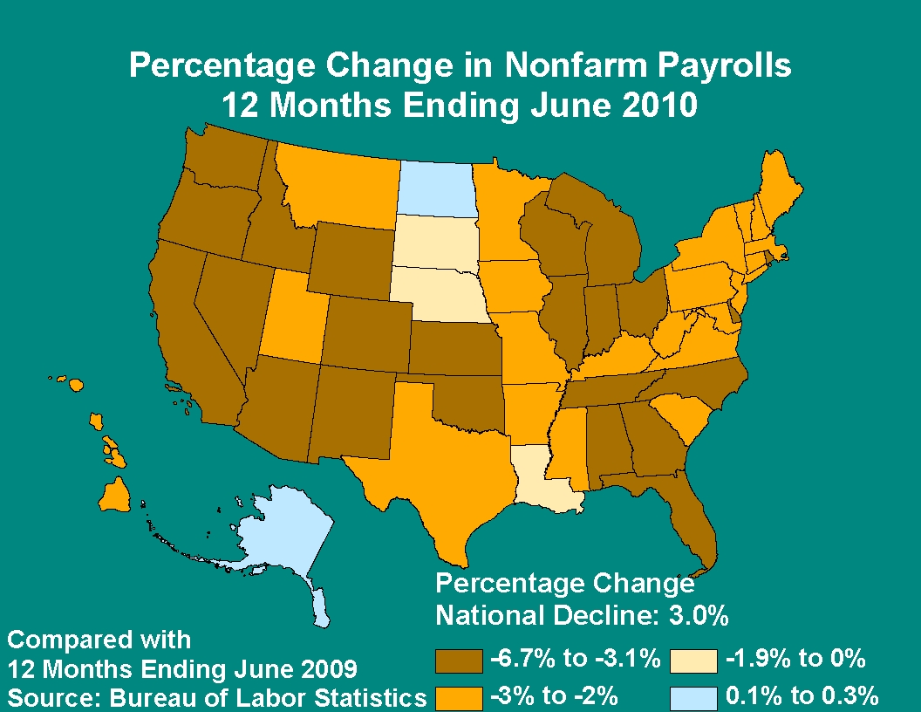

Slide 6
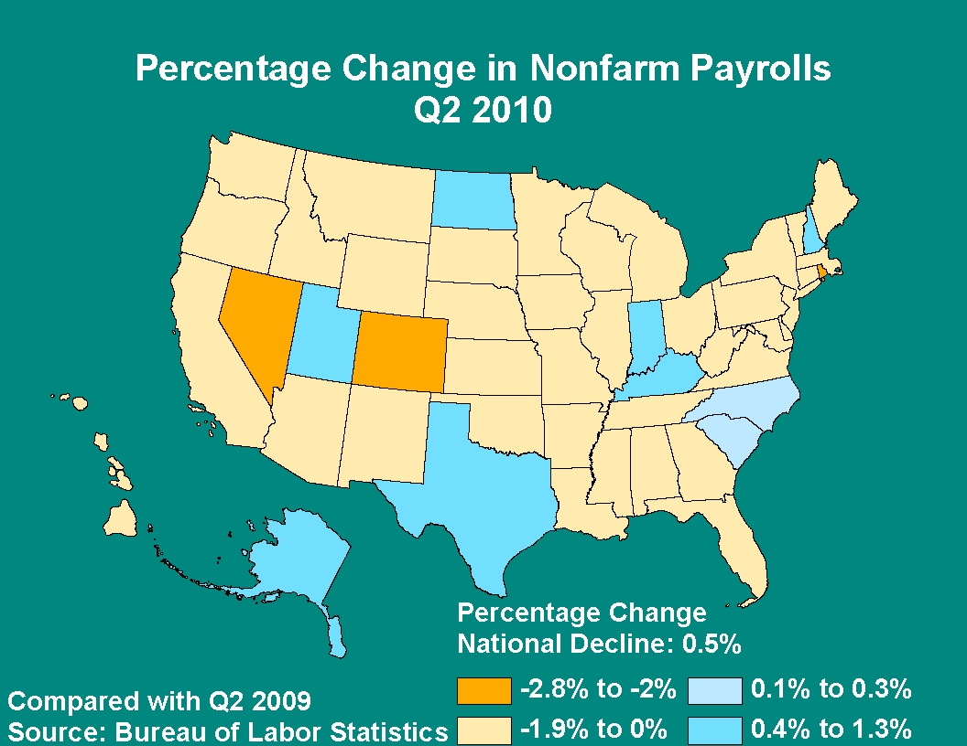

Slide 7
Nonfarm Change by Sector
Percentage Change 12 months ending June 2010

Slide 8
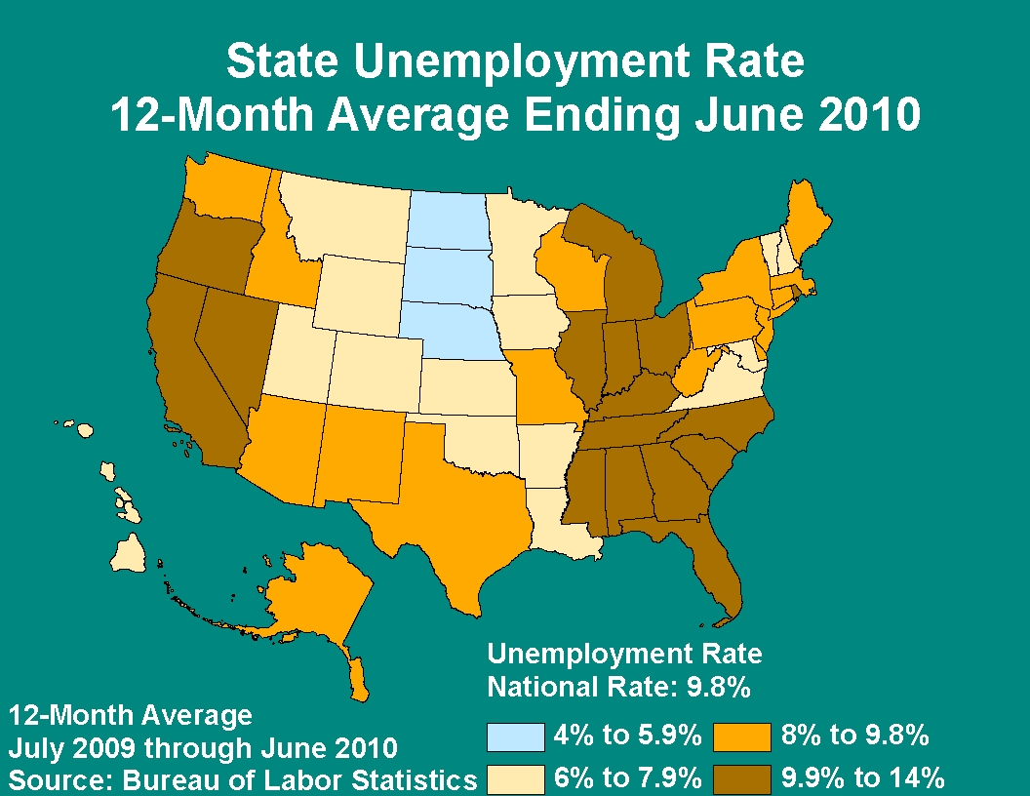

Slide 9
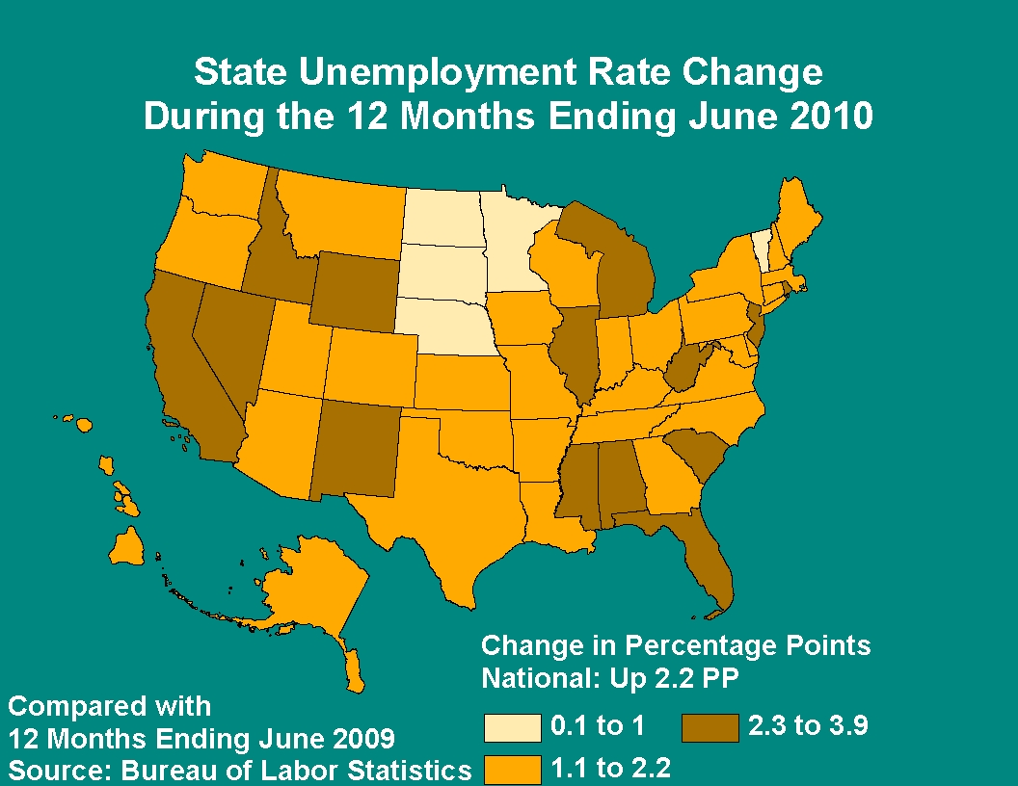

Slide 10
Sales market conditions remain soft in much of the country
but continue to improve in many areas
Data on home sales prices indicate improvement
Home sales are up (homebuyer tax credit)
Inventories of new and existing homes for sale are down
from a year ago and coming closer to balance
Rental market conditions are mixed throughout the country
Significant declines in multifamily permits have continued
U.S. Housing Market Conditions: 2Q 2010

Slide 11
Regional Conditions 2Q 2010
 | Sales Markets | Rental Markets
Region I (New England) | Balanced | Balanced
Region II (NY/NJ) | Slightly Soft | Balanced (NYC Tight)
Region III (Mid-Atlantic | Slightly Soft | Mixed
Region IV (Southeast-Caribbean) | Soft | Soft
Region V (Midwest | Soft | Mixed (soft/balanced)
Region VI (Southwest) | Slightly Soft | Soft
Region VII (Great Plains) | Balanced (Soft in MO) | Soft
Region VIII (Rocky Mountains) | Soft | Mixed
Region IX (Pacific) | Soft | Mixed
Region X (Northwest) | Soft | Balanced

Slide 12
  National Home Price Indices
  Based on Qtr. To Same Qtr. Previous Year

Slide 13
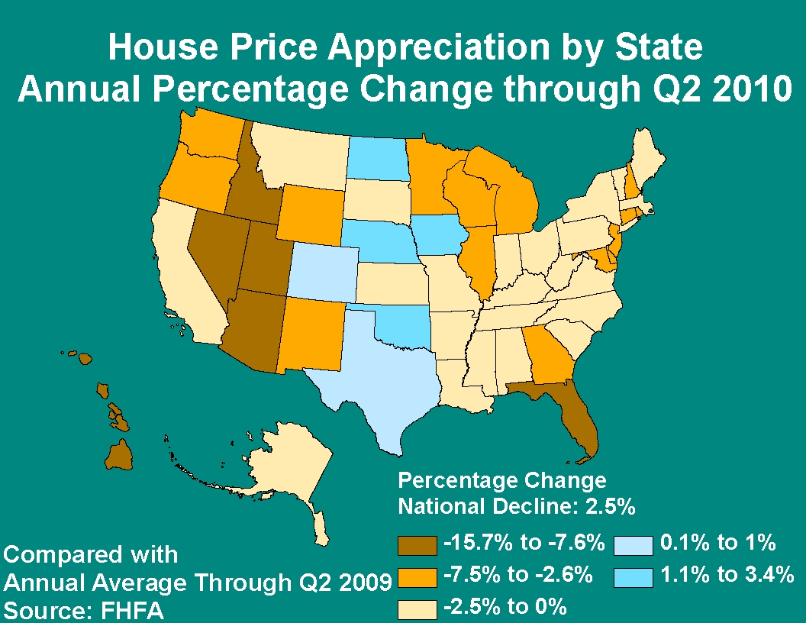

Slide 14
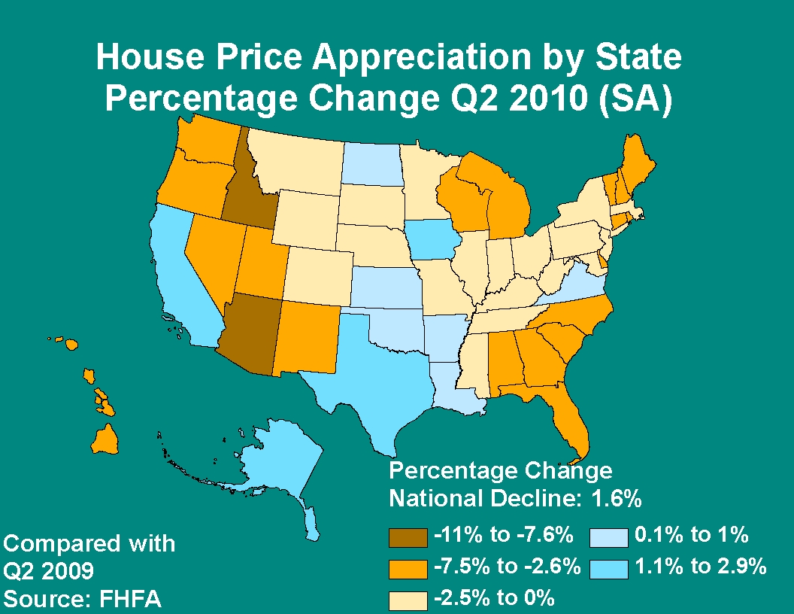

Slide 15
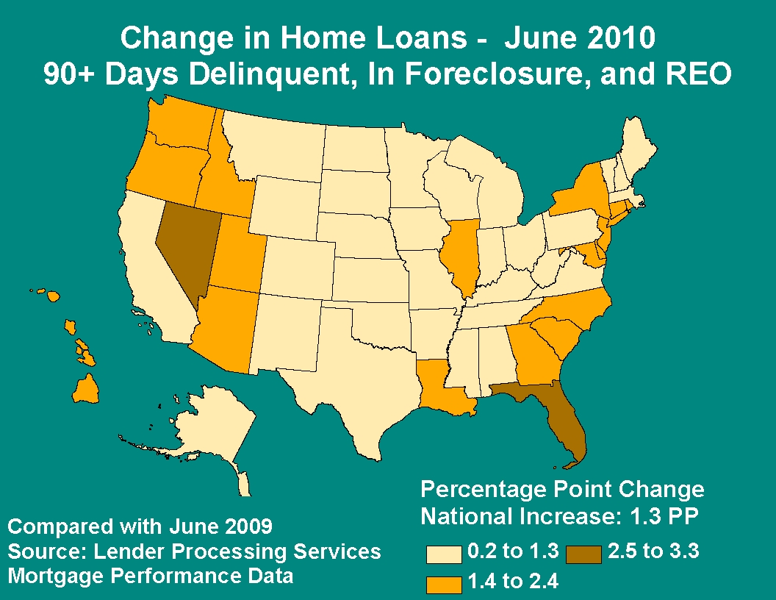

Slide 16
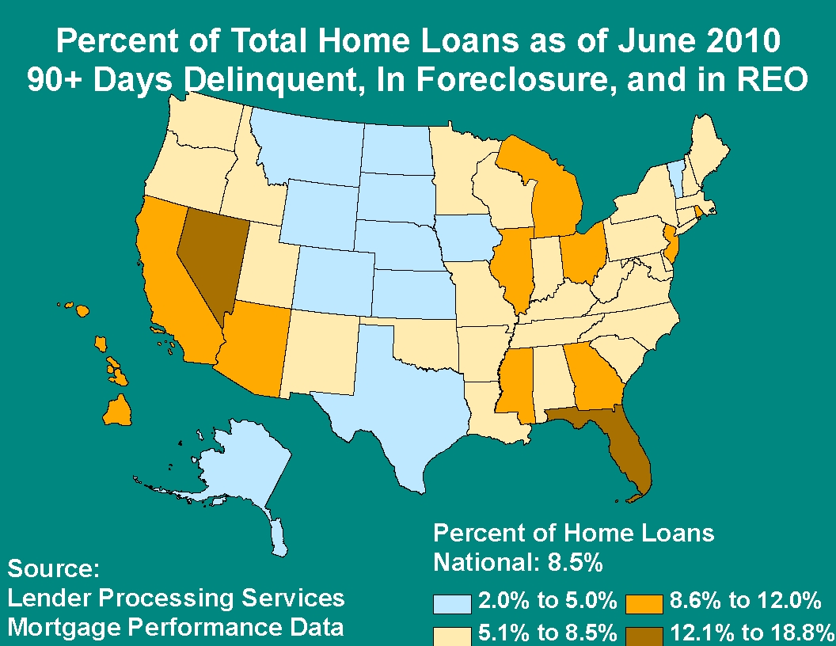

Slide 17
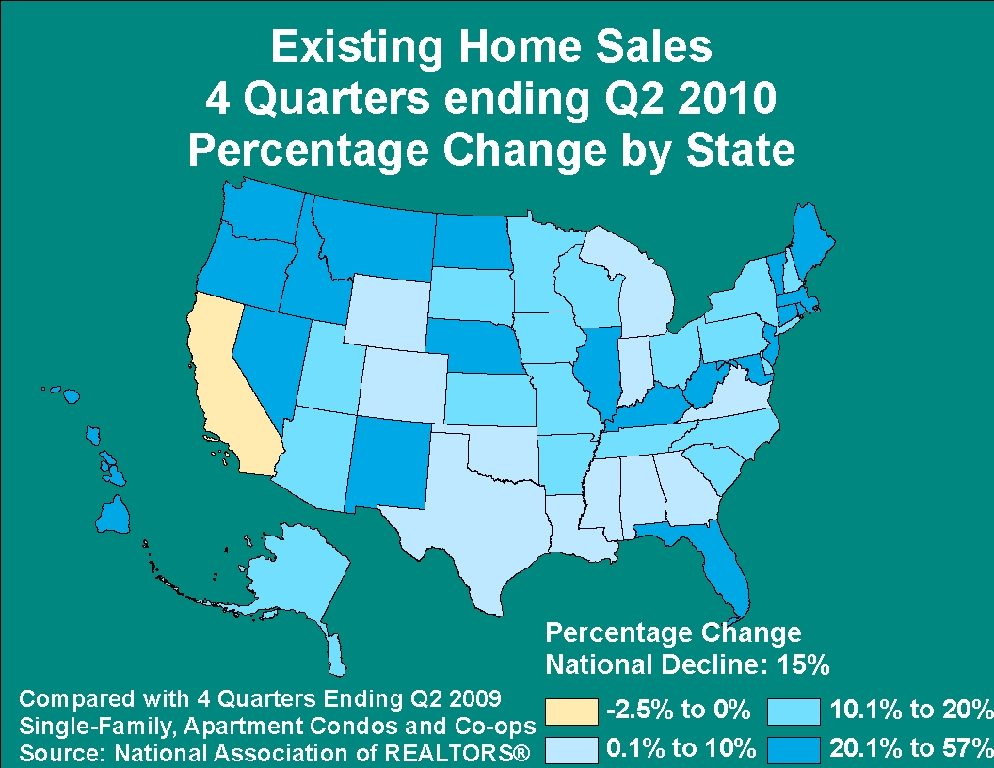

Slide 18
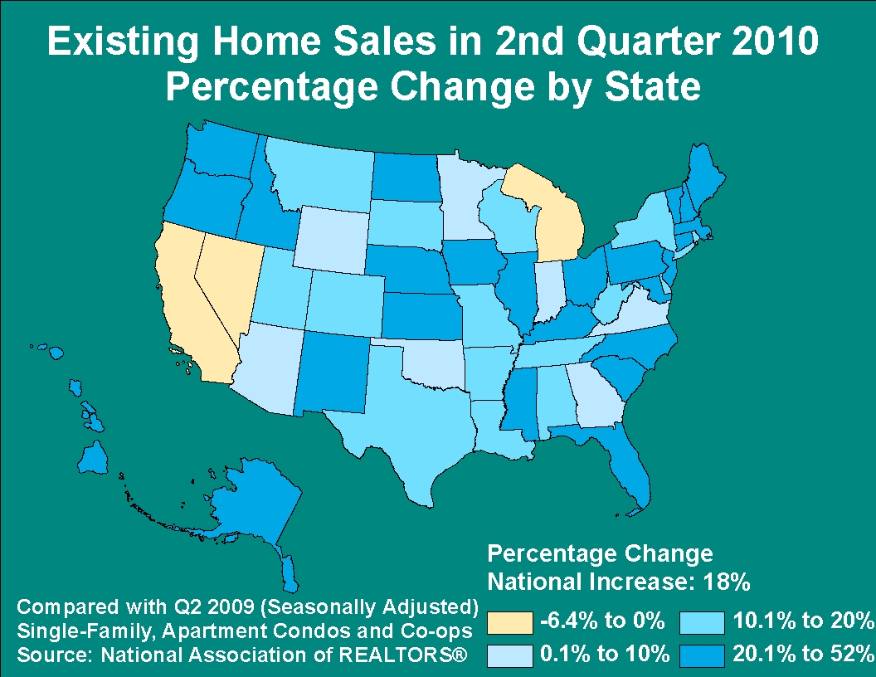

Slide 19
SF Permit Activity
During 12 Months Ending

Slide 20
Percentage Change in SF Activity
12 Months Ending 6/09 to 6/10

Slide 21
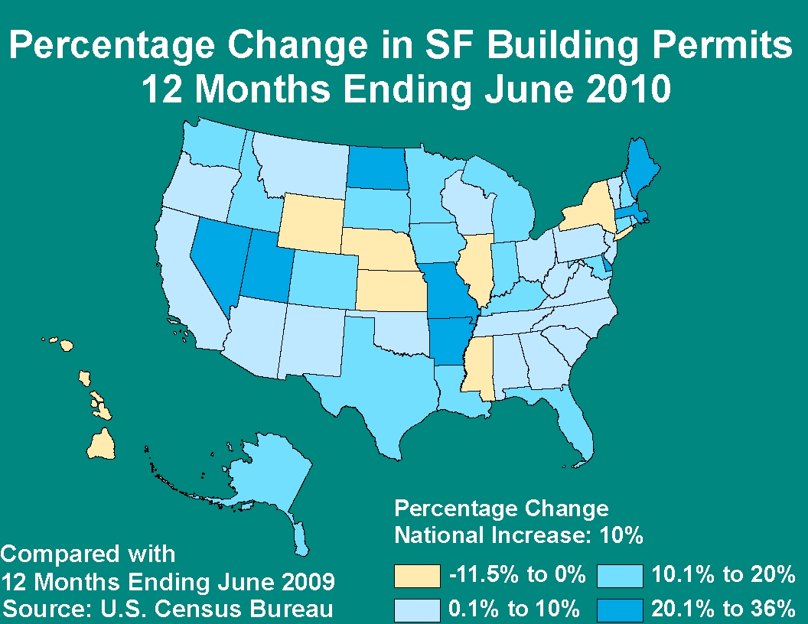

Slide 22
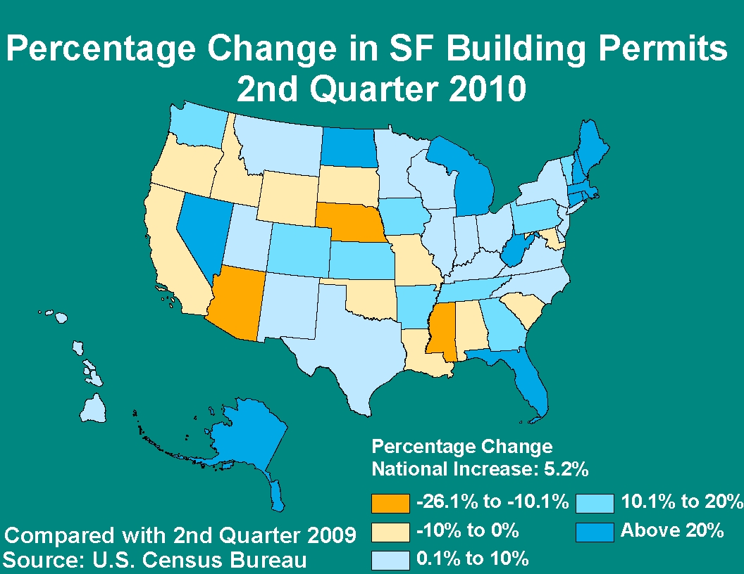

Slide 23
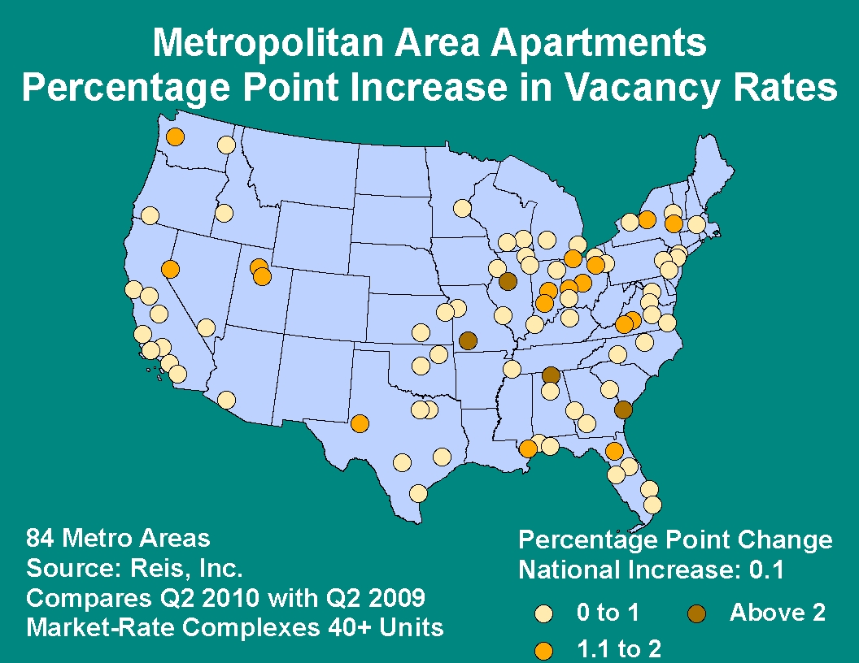

Slide 24
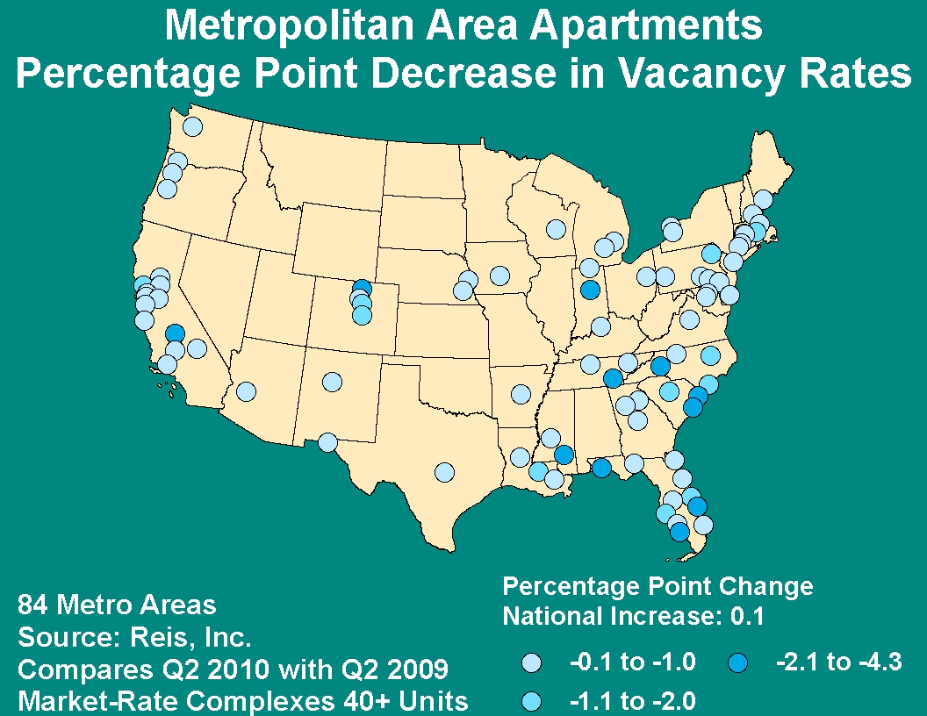

Slide 25
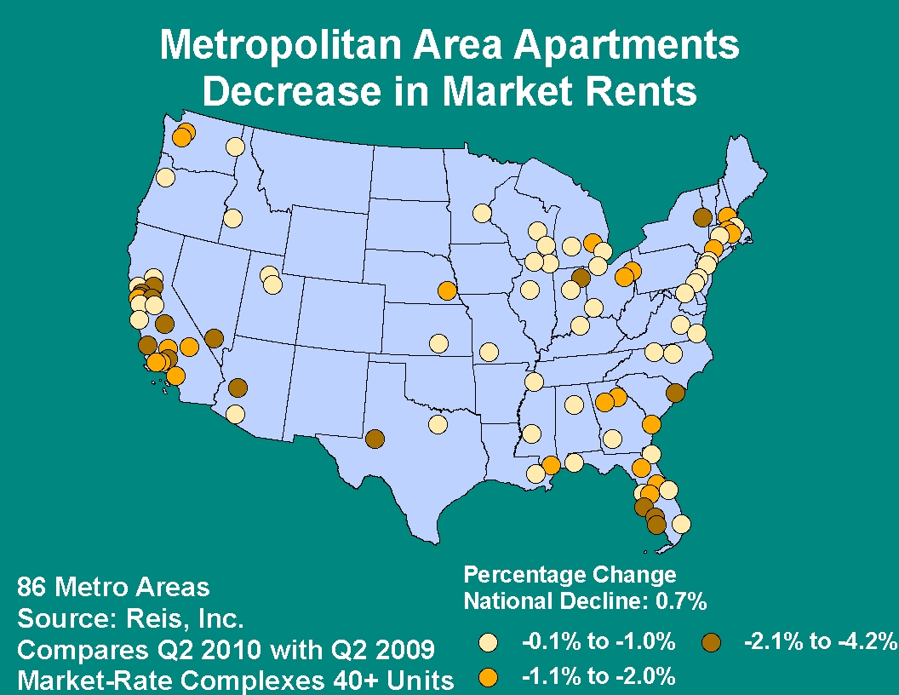

Slide 26
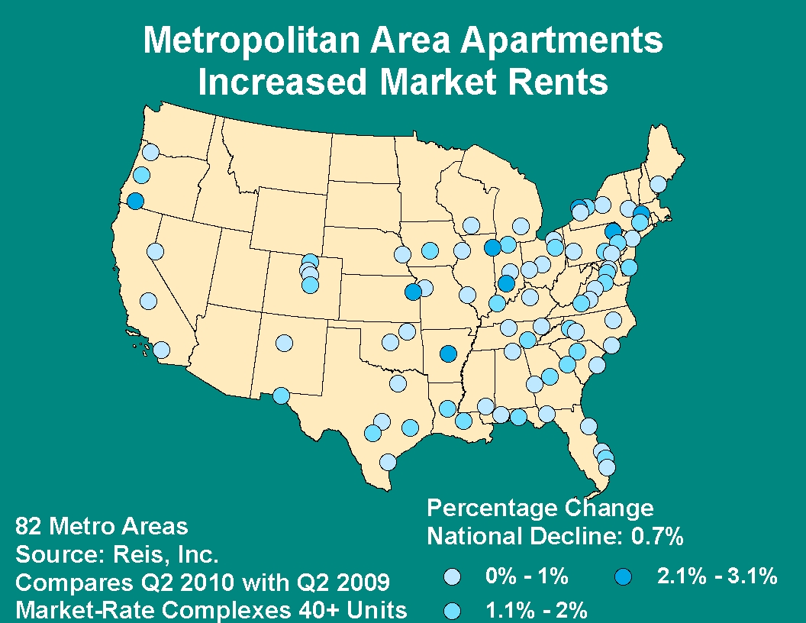

Slide 27
MF Permit Activity
During 12 Months Ending

Slide 28
Percentage Change in MF Activity
12 Months Ending 6/09 to 6/10

Slide 29
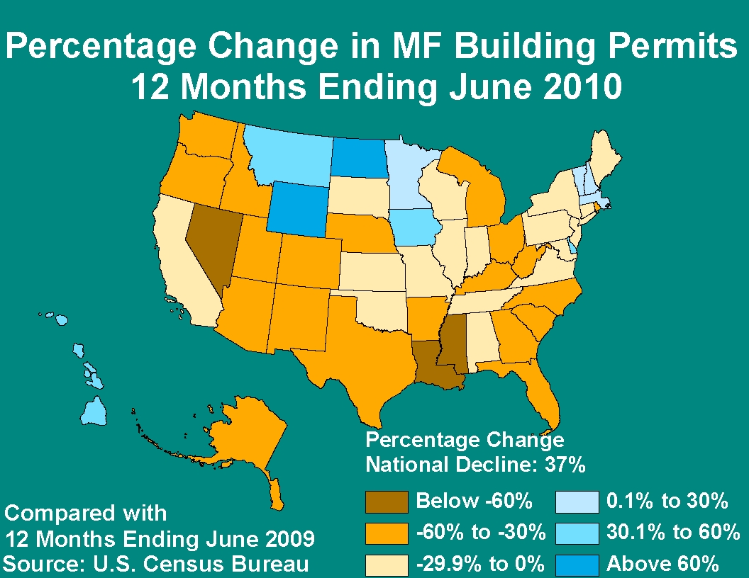

Slide 30
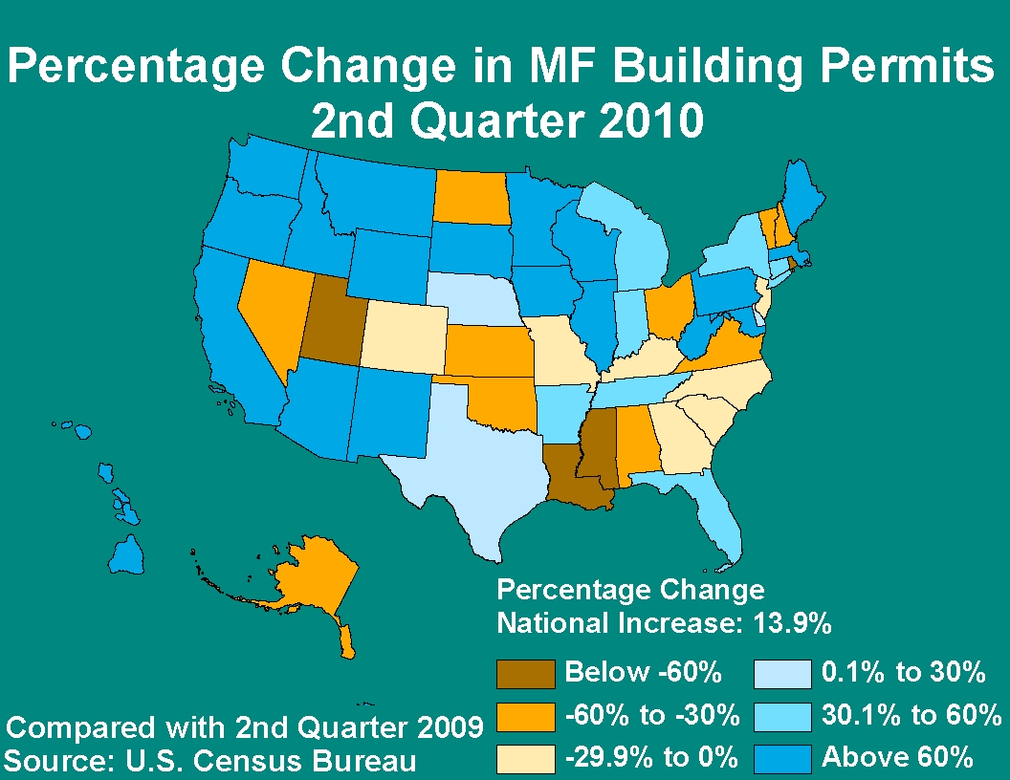

Slide 31
For additional information:
  U.S. Housing Market Conditions Report
  2Q 2010 available at www.huduser.org
  Contact your local Regional or Field
  Economist
  Contact me at kevin.p.kane@hud.gov

